Slide 1

Welcome to herons
Meet and Greet
I am always contactable via herons@sutton-st-james.lincs.sch.uk should you ever have any questions, queries or concerns.

Slide 2
Hello There!
Welcome to the 2024/25 academic year.
Please take a look through this PowerPoint to gather an insight into what your child will experience this year, and the changes we have made in comparison to recent years.
I will remain fully contactable at the end of the school day or via herons@sutton-st-james.lincs.sch.uk should you have any questions, queries or concerns.
Thank you.

Slide 3


Slide 4

Through mindset, each child will be taught about the importance of resilience. They will learn that in order to better themselves, failure must come as part of the process.
This will be delivered in a structured way and taught as part of a journey, rather than a series of lessons.

Slide 5
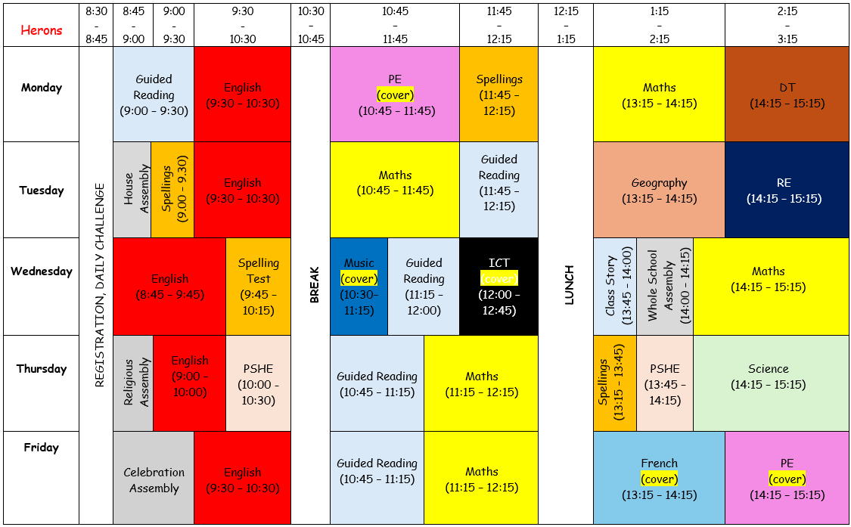
TIMETABLE
A general weekly timetable will look similar to the one on the right, ensuring a wide coverage of the curriculum. The subjects, History and Geography will alternate every half term, as will the subjects, Art and DT.

Slide 6
uNiform
Children are expected to wear the correct school uniform at all times.
Black school shoes, not trainers
Long hair must be tied back
PE t-shirt to be house colours:
Nene = Green
Ouse = Yellow
Welland = Red
Witham = Blue
No earrings to be worn in a PE lesson
If there are any issues with any of the information mentioned above, please get in contact.
PE kit

Slide 7
Homework
Homework will be given out on a Thursday and will be expected back in by the following Tuesday. All children have been given laminated cards with their login details and passwords on.
Maths/English = An activity sheet for both will be stuck in your child’s home learning book to complete. This will be linked to the current week’s learning so you can see what your child has been learning about in class.
Reading = children to login to www.readtheory.org where they are to complete 2 x read theories at 75% or greater. Read theories can be counted in your child’s reading record.
Spelling = An activity sheet will be stuck in your child’s English home learning book to complete. Furthermore, children can visit www.spellingshed.com where they can interact with the current week’s spelling words.
Any homework not complete will involve your child completing it in their own time, either at break or lunchtime.
Maths
English
Reading
Spelling

Slide 8
Topics across the year
World War II
Space
The Maya

Slide 9

The Behaviour management Chart
Good behaviour
Children will receive house shells for upholding the school’s values. They will be able to use these for personal purchases from the Shell Shop (in school). The shells earned throughout a week will also be gathered from all pupils, totalled at the end of each week, and revealed as part of Friday’s celebration assembly.
Poor behaviour
For any negative decisions being made, children will be moved down on the time-out board and encouraged to reflect on their decision during their lunchtime.
Orange = 5-minute timeout
Red = 10-minute timeout
For seriously poor behaviour, an immediate reflection will be issued instead of the time-out board being used.

Slide 10
Expectations
My expectation is for the children in Herons class to set the very best example to the rest of the school.
Behaviour
Equal respect for all children, staff and visitors.
Effort
To give nothing less than 100% in everything.
Presentation
To uphold a neat and tidy appearance, along with neat and tidy learning books.
Attitude
To maintain a growth mind set.

Slide 11
How can you best support the school?
Label any clothing
Clothing in lost property last year was at an all-time high in every year group which comes at a high cost for all parents. Please could you ensure that everything is labelled, right down to shoes and socks.
Behavioural issues
For children to make the right choices, they need every adult in their life working alongside each other to set the very best example. If you ever need to speak to me, please do as quickly as possible with an open mind.
Reading
There’s no denying that reading has the biggest beneficial factor on a child’s development. The more they read, the more they’ll progress.
Timestables
Maths in year 5 & 6 is the easiest subject for a child to engage with if they know their timestables. It is across every sub-topic.
Label any clothing
Behavioural issues
Reading
Timestables

Slide 12

Any Questions?
If you have any questions, then please do not hesitate to speak to me on the school gate or email me directly.
As always, thank you very much for your continued support and I look forward to a positive year ahead!
Kindest regards,
Mr Richardson
herons@sutton-st-james.lincs.sch.uk

