Slide 1

Welcome to herons
Meet and Greet
I am always contactable via herons@sutton-st-james.lincs.sch.uk should you ever have any questions, queries or concerns.

Slide 2



Slide 3


Slide 4


Slide 5



Slide 6
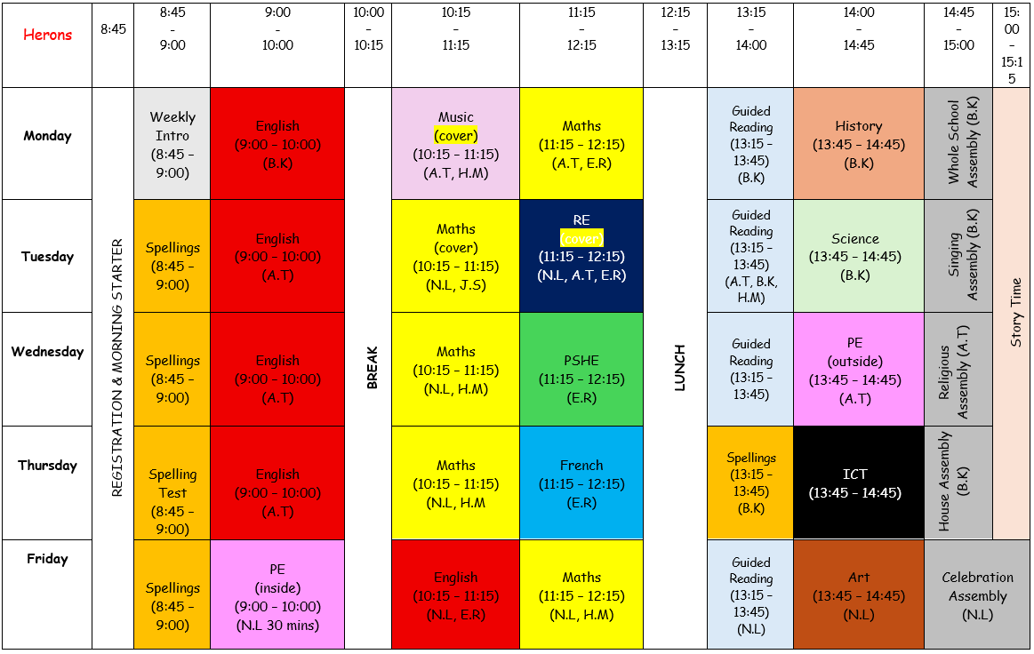
Main Timetable

Slide 7
uNiform
Children are expected to wear the correct school uniform at all times please.
Black school shoes, not trainers
Long hair must be tied back
PE t-shirt to be house colours:
Nene = Green
Ouse = Yellow
Welland = Red
Witham = Blue
No earrings to be worn in a PE lesson
If there are any issues with any of the information mentioned above, please get in contact.
PE kit

Slide 8
Homework
Maths
Spellings
Reading
Given Out on A Thursday…
… Handed back In on a Tuesday.

Slide 9

MATHS

Slide 10

Spellings
Children will log tricky spellings in their new spelling logbook so that they’re able to learn them more easily.

Slide 11

Read theory
www.readtheory.org
All children’s login details are in their reading record (first page).
Supporting their comprehension skills; not just their reading

Slide 12
Topics across the year
Invaders & Settlers
It’s Good to be Me
Greece is the Word

Slide 13

Rewards & Sanctions

Slide 14
Expectations
Our expectation is for the children of Herons class to set the very best example to the rest of the school.
Behaviour – equal respect for all children, members of staff and visitors
Effort
Presentation
Attitude

Slide 15
How can I best support my child?
Label any clothing
Behavioural issues
Reading
Timestables

Slide 16

Any Questions?
herons@sutton-st-james.lincs.sch.uk
Thank you,
Mr Richardson

