Slide 1

Welcome to SWANS
Meet and Greet
I am always contactable via swans@sutton-st-james.lincs.sch.uk should you ever have any questions, queries or concerns.

Slide 2
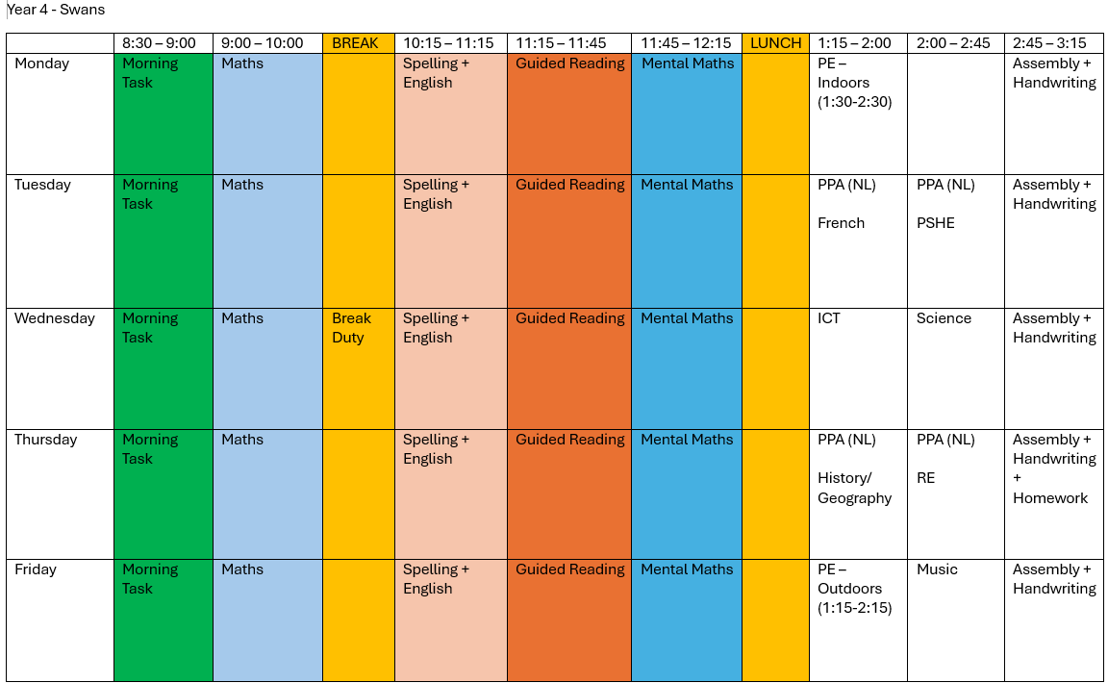
Timetable

Slide 3
uNiform
Children are expected to wear the correct school uniform at all times.
Black school shoes, not trainers
Long hair must be tied back
PE t-shirt to be house colours:
Nene = Green
Ouse = Yellow
Welland = Red
Witham = Blue
No earrings to be worn in a PE lesson
PE days are Monday and Friday
If there are any issues with any of the information mentioned above, please get in contact.
PE kit

Slide 4
Homework
Maths
Reading
Spelling
Given Out on A Thursday…
… Handed back In on a Tuesday.

Slide 5


MATHS
ENGLISH

Slide 6

Spelling shed
www.spellingshed.com/en-gb
Cards have been given to all children with their login details and passwords on.
Gets children to learn their spellings… in a fun way.

Slide 7
Topics across the year
Sticks & Stones
Road to Rome!
Fur, Feathers and Fangs

Slide 8

Rewards & Sanctions

Slide 9
Expectations
Our expectation is for the children of Swans class to be the best that they can be.
Behaviour – equal respect for all members of staff and visitors
Effort
Presentation
Attitude

Slide 10
How can I best support my child?
Label any clothing
Behavioural issues
Reading
Timestables, timestables, timestables!

Slide 11
Any Questions?
swans@sutton-st-james.lincs.sch.uk
Thank you,
Miss Dring

